Slide 1
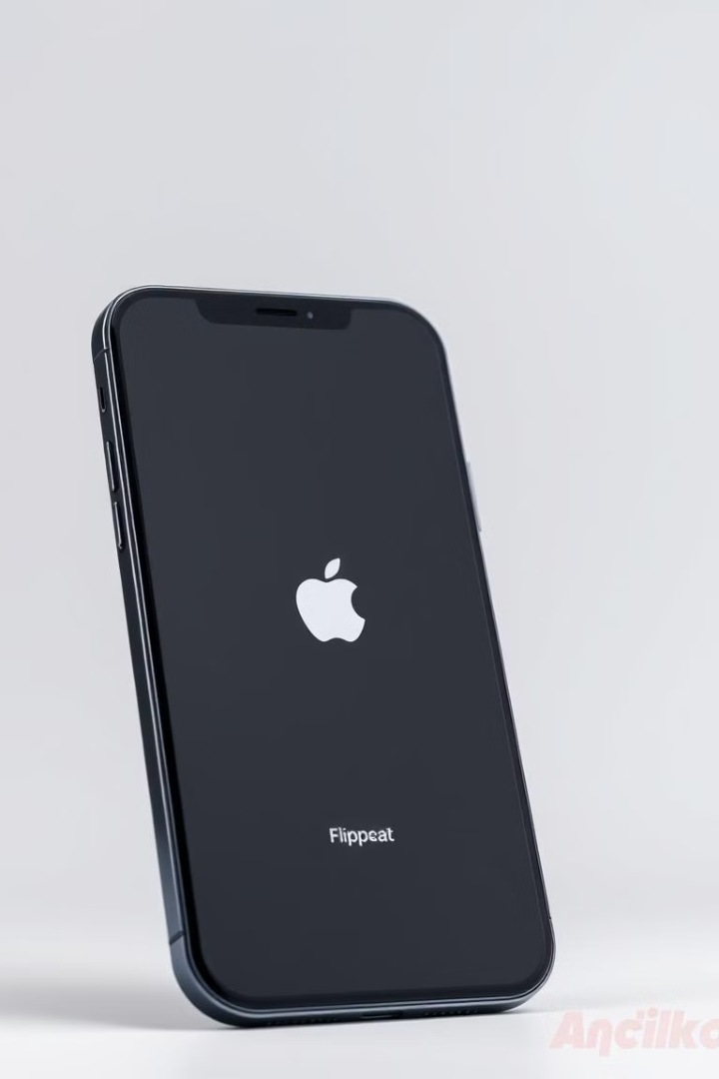

E-Commerce Data Analysis: Apple iPhones on Flipkart
Analysis of Apple iPhone data scraped from Flipkart, including data cleaning, EDA, clustering, and model deployment.
by Gaurav kumar singh

Slide 2
Data Scraping and Initial Dataframe
Selenium Webdriver
BeautifulSoup
Pandas Dataframe
Used to automate browser and scrape data from Flipkart.
Parsed HTML content to extract product information.
Data organized into a structured table for analysis.

Slide 3
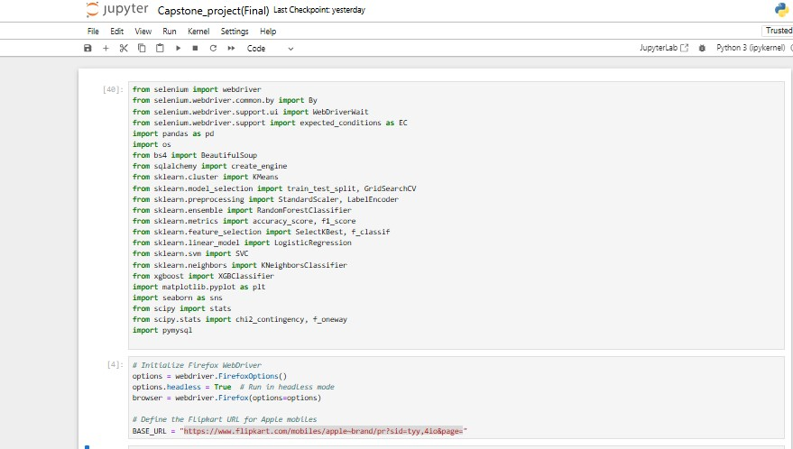
Data Scraping and Initial Dataframe
Selenium Webdriver
BeautifulSoup
Pandas Dataframe
Used to automate browser and scrape data from Flipkart.
Parsed HTML content to extract product information.
Data organized into a structured table for analysis.

Slide 4
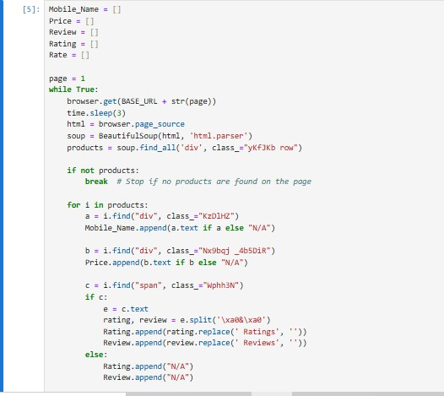
Data Scraping and Initial Dataframe
Selenium Webdriver
BeautifulSoup
Pandas Dataframe
Used to automate browser and scrape data from Flipkart.
Parsed HTML content to extract product information.
Data organized into a structured table for analysis.

Slide 5
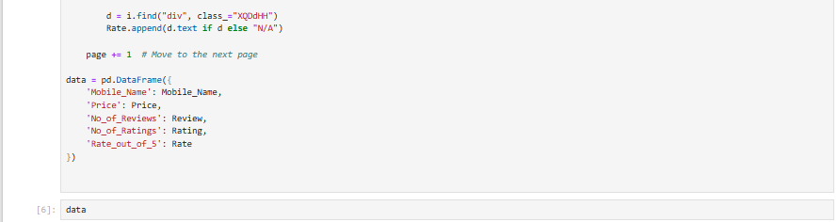
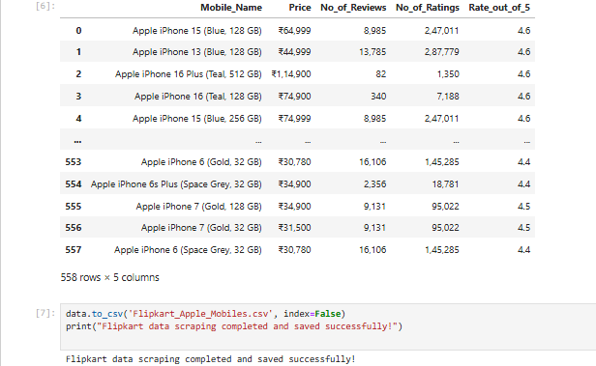
Data Scraping and Initial Dataframe
Selenium Webdriver
BeautifulSoup
Pandas Dataframe
Used to automate browser and scrape data from Flipkart.
Parsed HTML content to extract product information.
Data organized into a structured table for analysis.

Slide 6

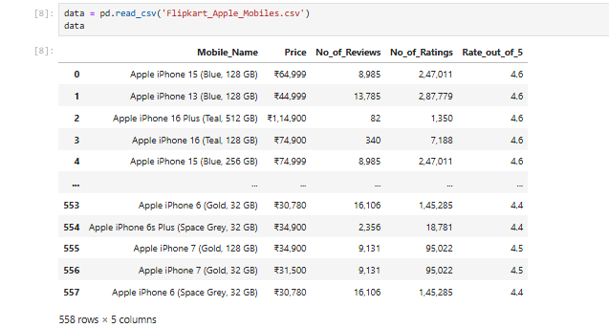
Data Cleaning and Preprocessing
1
Missing Values
2
Duplicates
Handled missing data by replacing "N/A" with None.
Removed duplicate entries to ensure data integrity.
3
Data Types
Converted price, reviews, and ratings to appropriate types.

Slide 7
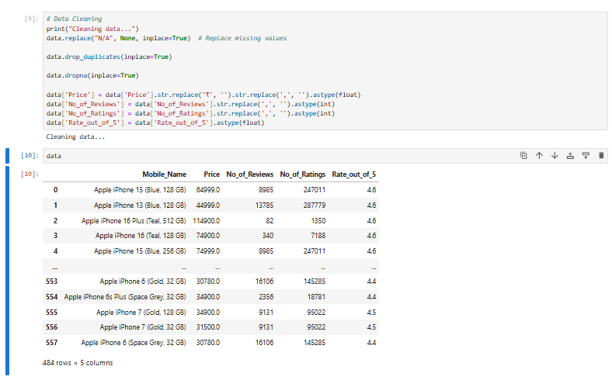
Data Cleaning and Preprocessing
1
Missing Values
Duplicates
2
Handled missing data by replacing "N/A" with None.
Removed duplicate entries to ensure data integrity.
3
Data Types
Converted price, reviews, and ratings to appropriate types.

Slide 8
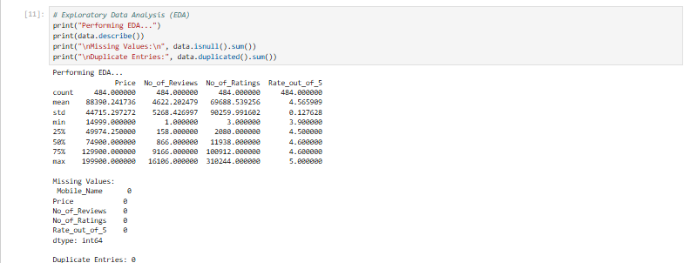
Exploratory Data Analysis (EDA)
Descriptive Stats
Missing Values
Duplicate Entries
Mean price: ₹88,390
No missing values after cleaning.
No duplicate entries.

Slide 9
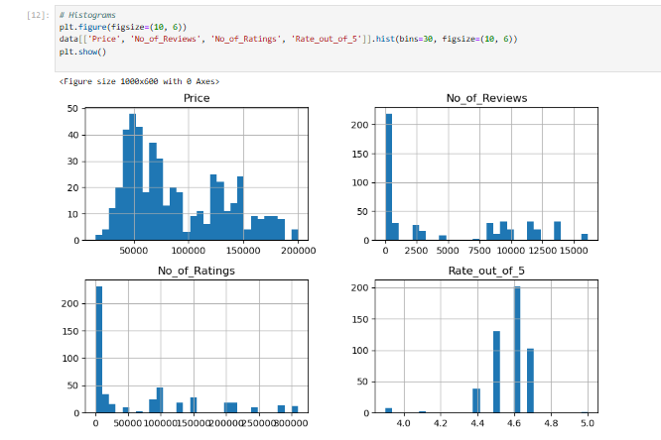
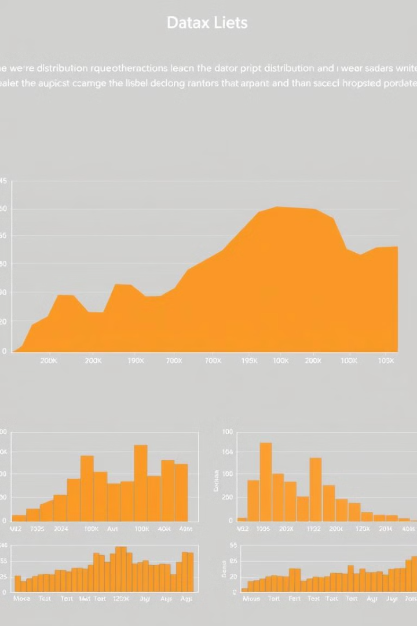


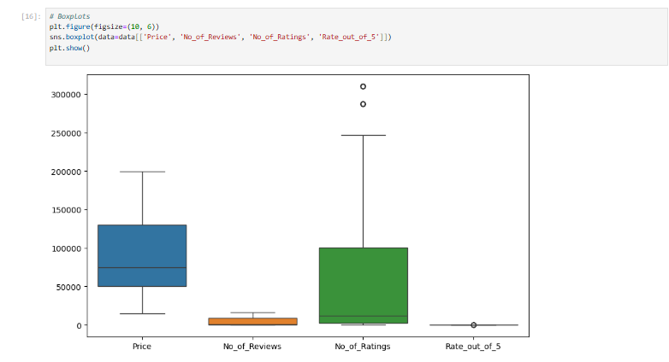
Histograms and Boxplots
Histograms
Boxplots
Visualized distribution of price, reviews, and ratings.
Identified outliers in the dataset.

Slide 10
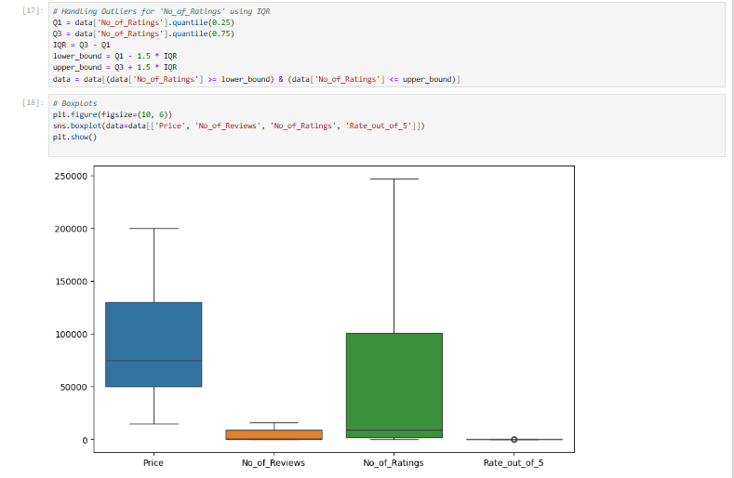
Outlier Handling
1
IQR Method
Used IQR to identify and remove outliers.
2
Ratings
Specifically handled outliers in 'No_of_Ratings' column.
3
Boxplots
Visualized data after outlier removal.

Slide 11
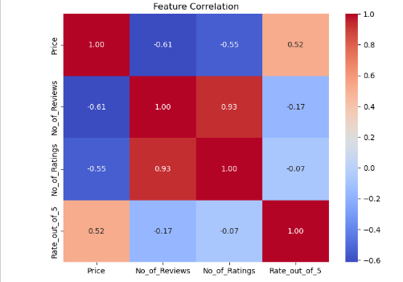
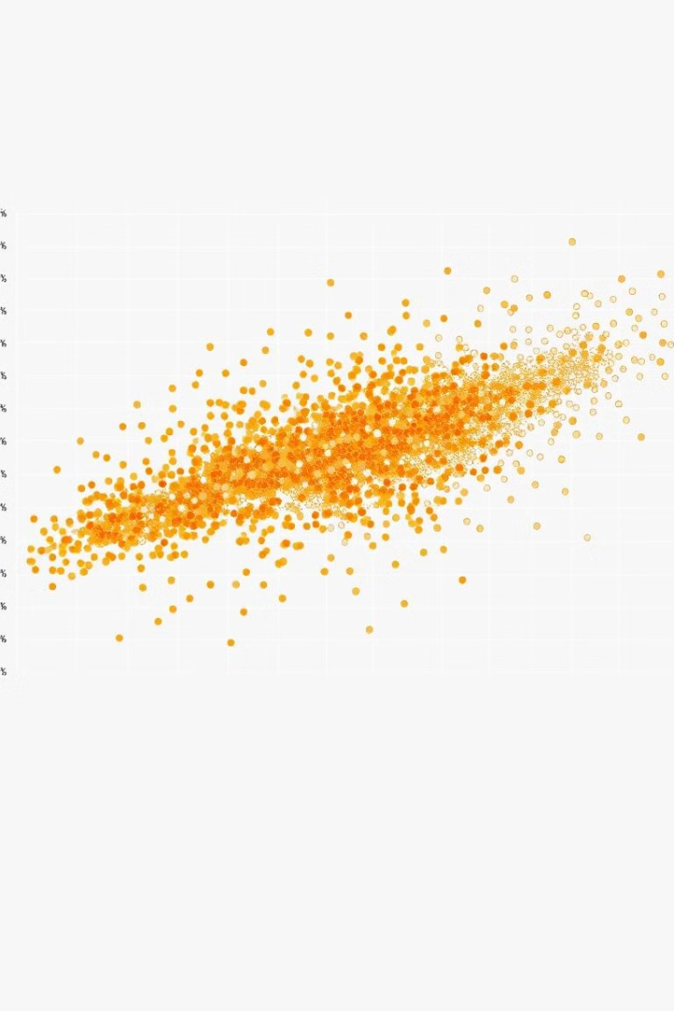


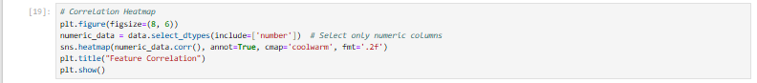
Feature Correlation Heatmap
Correlation Matrix
Calculated correlation between numeric features.
Heatmap
Visualized correlation matrix using a heatmap.

Slide 12



K-Means Clustering
2
K-Means
1
Scaling
Clusters
3

Slide 13



Hypothesis Testing
1
T-test
2
ANOVA
3
Chi-Square
Average price differs from ₹50,000. Price ranges affect ratings.

Slide 14
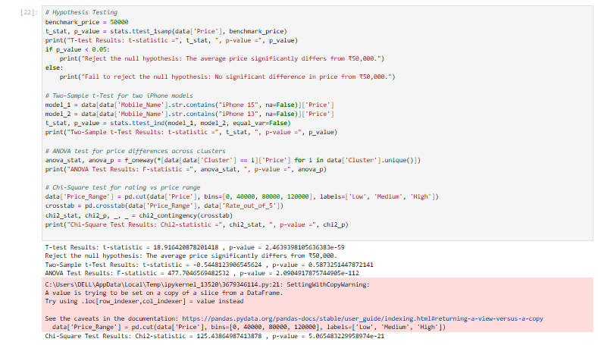
Hypothesis Testing
1
T-test
2
ANOVA
3
Chi-Square
Average price differs from ₹50,000. Price ranges affect ratings.

Slide 15
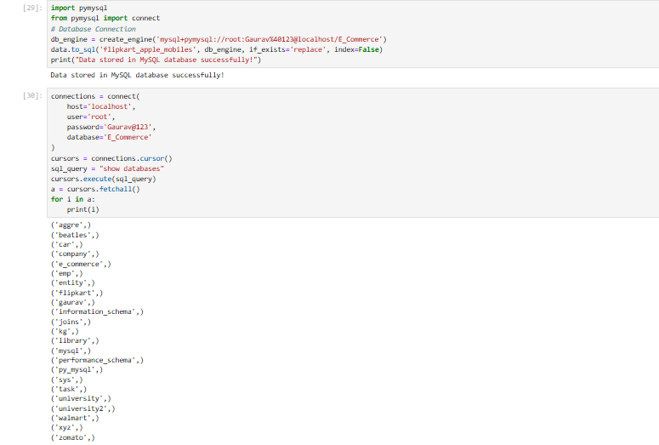



Efficient Data Storage
Database Setup
Tools Used
Purpose
We utilize relational databases like MySQL to store the cleaned data. These systems offer efficient data management and retrieval. Database selection impacts performance and scalability.
SQLAlchemy and Pandas are employed for seamless database integration and data manipulation. These tools enhance productivity and streamline data workflows. Effective tools improve development efficiency.
The primary purpose of data storage is to enable efficient data retrieval and management. This ensures that data is readily accessible for analysis and reporting. Organized data supports informed decision-making.

Slide 16
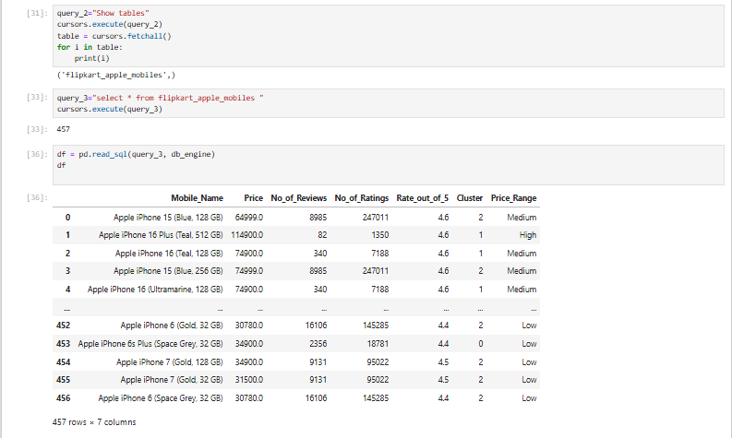
Efficient Data Storage
Database Setup
Tools Used
Purpose
We utilize relational databases like MySQL to store the cleaned data. These systems offer efficient data management and retrieval. Database selection impacts performance and scalability.
SQLAlchemy and Pandas are employed for seamless database integration and data manipulation. These tools enhance productivity and streamline data workflows. Effective tools improve development efficiency.
The primary purpose of data storage is to enable efficient data retrieval and management. This ensures that data is readily accessible for analysis and reporting. Organized data supports informed decision-making.

Slide 17
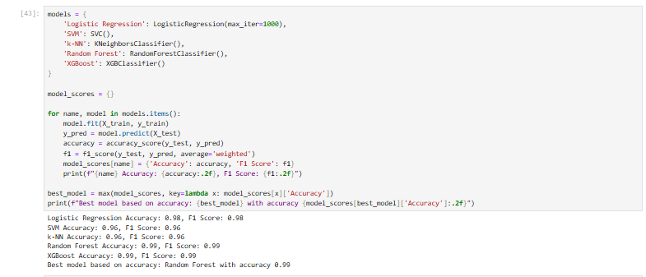
Supervised Learning for Prediction
1
Objective
The objective is to predict product categories or labels using supervised learning algorithms. Accurate predictions can improve product recommendations and marketing efforts. Predictive models drive targeted marketing.
2
Algorithms
We implement various algorithms, including Logistic Regression, Support Vector Machine (SVM), k-Nearest Neighbors (k-NN), Random Forest, and XGBoost. Diverse algorithms enhance prediction accuracy. Algorithm diversity improves robustness.
3
Evaluation Metrics
We evaluate model performance using metrics such as Accuracy and F1 Score to ensure reliable and effective predictions. Metrics provide quantitative performance indicators. Performance measurement ensures quality.

Slide 18
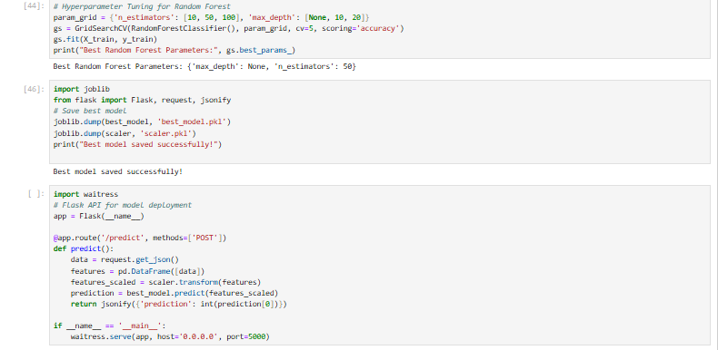

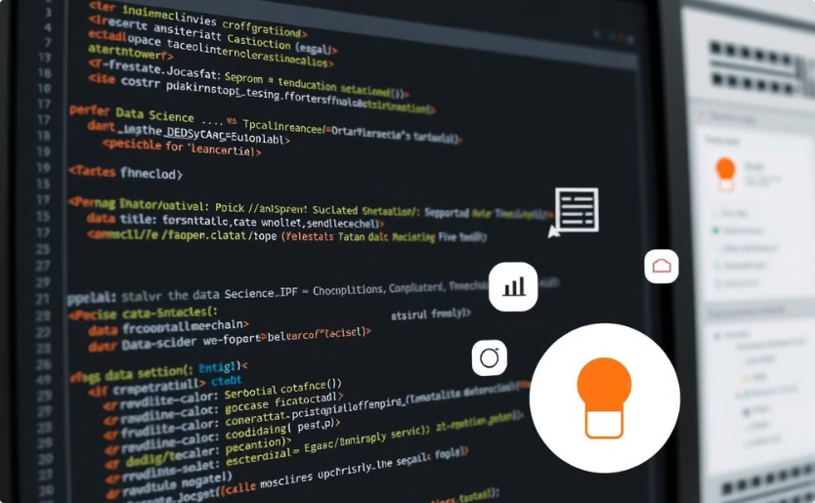
Model Building and Deployment
Model Training
Flask API
Trained models like Logistic Regression, SVM, Random Forest.
Deployed best model using Flask for predictions.

Slide 19
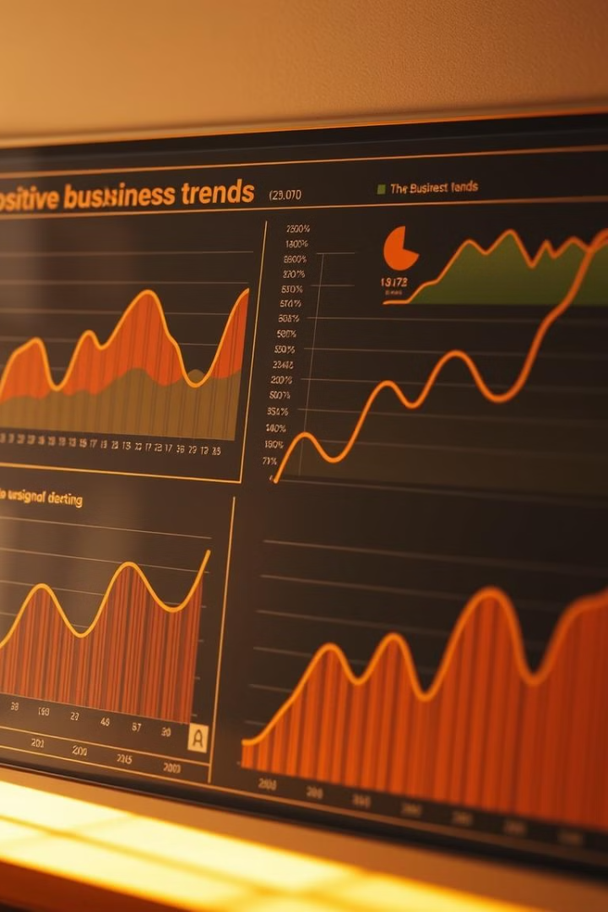
Key Findings
📌 Price Range Dominance: Most iPhones are priced between ₹40,000 - ₹80,000.
📌 Customer Reviews Correlation: Higher-rated models (4.6+) tend to receive more reviews.
📌 Cluster Analysis:
Budget Models: iPhone SE, iPhone 7, iPhone 8
Mid-Range Models: iPhone 11, 12, 13
Premium Models: iPhone 14 Pro, 15 Pro, 16
📌 Model Performance:
XGBoost & Random Forest: ~99% accuracy.
Logistic Regression & SVM: Moderate performance (~84%).
📌 Hypothesis Testing:
Premium models receive higher ratings on average.
Price and customer ratings are positively correlated.

Slide 20
Business Impact & Recommendations
💰 Dynamic Pricing Strategy: Adjust pricing for older models to boost sales.
🎯 Marketing Segmentation:
Budget-conscious customers → iPhone SE, iPhone 7, 8.
Mid-range buyers → iPhone 12, 13, 14.
Premium users → iPhone 15 Pro, 16.
📦 Stock Optimization: Maintain more inventory for high-rated models.
🤖 AI-Powered Recommendations: Use ML models to enhance personalized product suggestions.
🌟 Customer Engagement: Feature high-rated models in marketing campaigns.

Slide 21
Conclusion & Future Scope
📌 Conclusion
The analysis of Apple iPhones on Flipkart provides valuable insights into pricing trends, customer ratings, and product demand.
Machine Learning models (Random Forest & XGBoost) achieved ~99% accuracy, effectively predicting product ratings based on features like price and category.
Clustering analysis identified three product segments (Budget, Mid-Range, and Premium), enabling targeted marketing strategies.
Statistical tests confirmed that higher-priced iPhones tend to receive better ratings, influencing customer purchasing decisions.
The integration of data scraping, cleaning, storage, and analysis ensures a comprehensive data-driven decision-making approach for e-commerce businesses.
🚀 Future Scope
Expand to Other Brands: Extend the analysis to other smartphone brands (Samsung, OnePlus, etc.) for a broader market comparison.
Dynamic Pricing Model: Implement real-time price prediction models to suggest optimal pricing strategies based on demand and competition.
Sentiment Analysis: Analyze customer reviews using NLP techniques to understand sentiment trends and improve product offerings.
Recommendation System: Deploy an AI-based recommendation system for Flipkart users based on their browsing and purchase history.
Real-Time Data Pipeline: Automate the web scraping, data cleaning, and storage process to ensure continuously updated insights.
Cloud Deployment: Host the ML model on cloud platforms (AWS, GCP, or Azure) for scalability and real-time predictions.

